Slide 1

SPACE INVADERS GAME!
Group Members :
1. Anusha Gondhalekar 20104127
2.Sakshi Balekar 20104103
3.Maaz Mirza 20104124
4.Hamza Ansari 20104058
Project guide
Prof. Manasi Choche

Slide 2
CONTENTS
Introduction
Objectives
Scope
Features
Outcome of the project
Technology Stack
Block Diagram

Slide 3
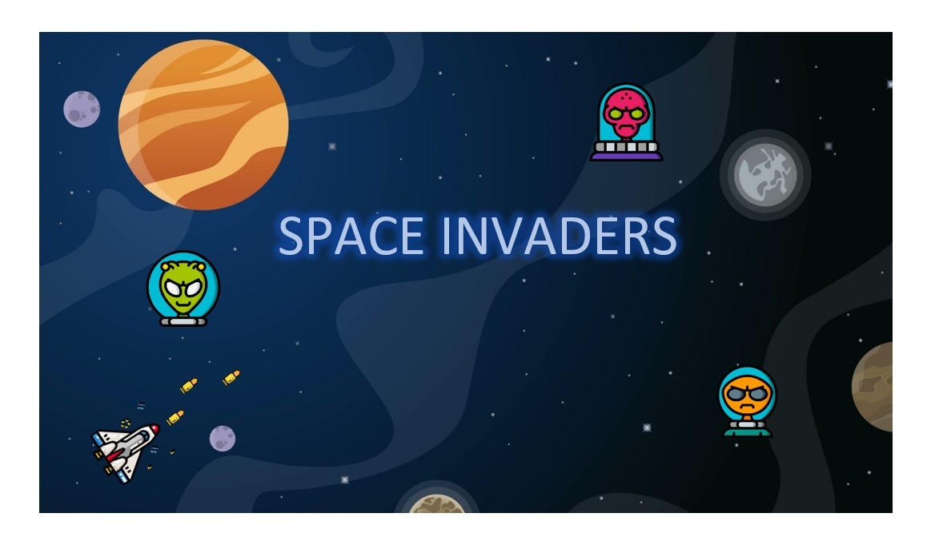
1. INTRODUCTION
Gaming is something that everybody is passionate about since childhood.
So, here we have come up with a concept of Space Invaders Game, which is a simple project designed in python.
Here, we have a spaceship that has to tackle the enemy aliens and traverse a path without getting collided by the aliens who will attack the spaceship.
The spaceship is basically suppose to collect the coins so that it can upgrade itself and move to the next level.

Slide 4

Purpose:
The main purpose of this game is to pass across a screen and shoot descending swarms of aliens, preventing them from reaching the bottom of the screen.
It is viewed as a pioneer of modern gaming.

Slide 5
2. OBJECTIVES
To provide players with the opportunity to make meaningful decisions in relation to playing the game.
To provide a framework within which players will operate, while the addition of narrative structures provide players with a reason to care about playing the game.
To establish the rules and narrative, an internally consistent game world is created, requiring visual, audio, and programming development for world, character, and level design
To provide overall contextual guidance on ambient mood, appropriate tone, and other less tangible aspects of the game world

Slide 6
3. SCOPE
No restrictions of any gender or age.
Kids can play this game indivisually when indoors whereas adults can play a good number of levels to kill their time while travelling or in between their busy schedule for relaxation.
Its a more interactive style of gameplay with the enemies responding to the player-controlled cannon's movement.
Has the ability to deal better with unexpected consequences.
Enhances a player's skills of observation, intuitive abilities.
Hone their alertness and concentration.

Slide 7
4. FEATURES
There are multiple levels with 5 lives and a health
bar to view the existing life of the player spaceship
The key feature of our game is that the player has to first login with the username and password that he has created in the start of the game.
There are animated player ship and enemies along with sound for every movement.
The player can view the details about the spaceship.
It is an individual player game.
Maximum distance covered by the spaceship takes the player to the next level of the game.
Collecting maximum coins while travelling will help the player to upgrade the spaceship.

Slide 8
5. OUTCOME OF PROJECT
The main outcome of the project is the amount of exposure and knowledge that one can gain throughout the progression of the project.
A fair conclusion to design such python projects with the games is that it works on an innovative idea where you are having fun.
The player can constantly research about the topic, and find ways to figure out the errors that you encounter throughout the procedure of the completion of the project.

Slide 9
6. TECHNOLOGY STACK
Programming language : Python
Operating system : Windows 10
Development environment : Pycharm, Pygame
Database : PostgreSQL

Slide 10
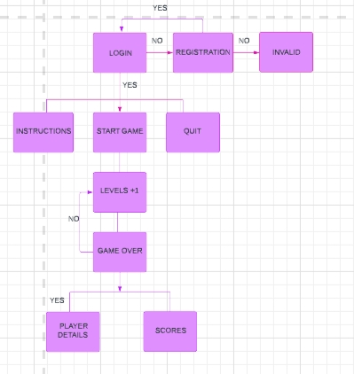
Flowchart:

Slide 11
THANK YOU!

